Slide 1
Bike shop
Group: IT2CCO-2113
Students: Navirdinov Dilshat & Kyrmagazyyev Olzhas

Slide 2
Introduction
We chose a site about bicycles, as cycling is a hot topic nowadays. With the help of our site, a person can choose the perfect bike for himself.

Slide 3
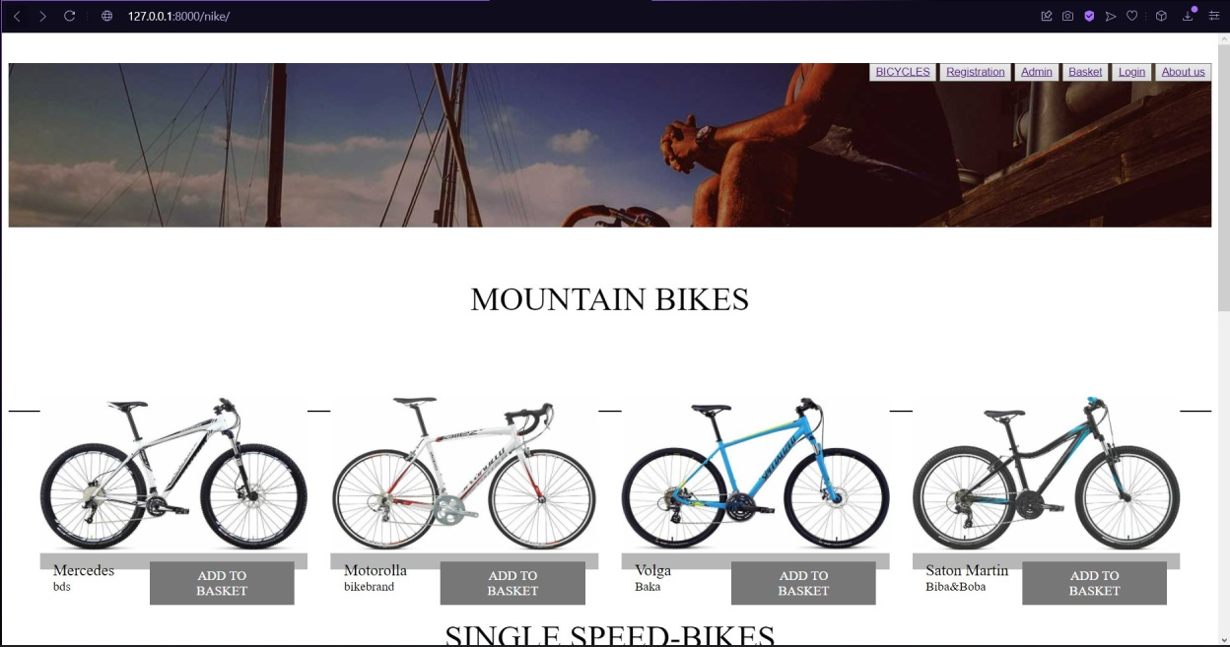
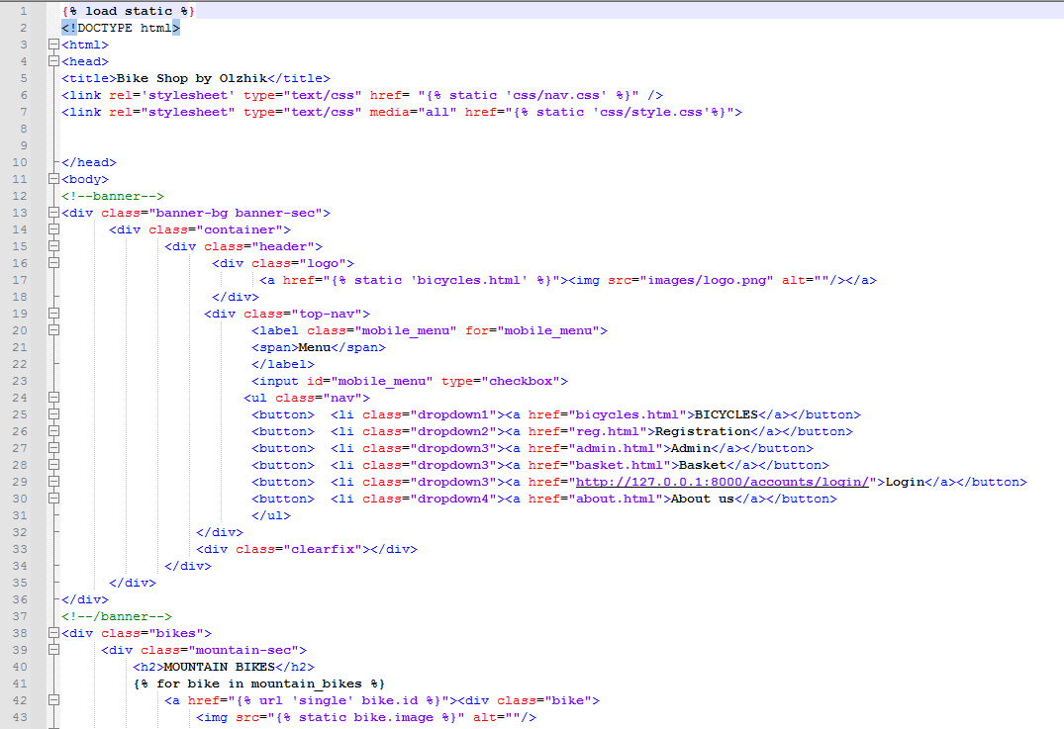
Main page
This is how the main page of the site looks like, here you can see the entire range of goods

Slide 4
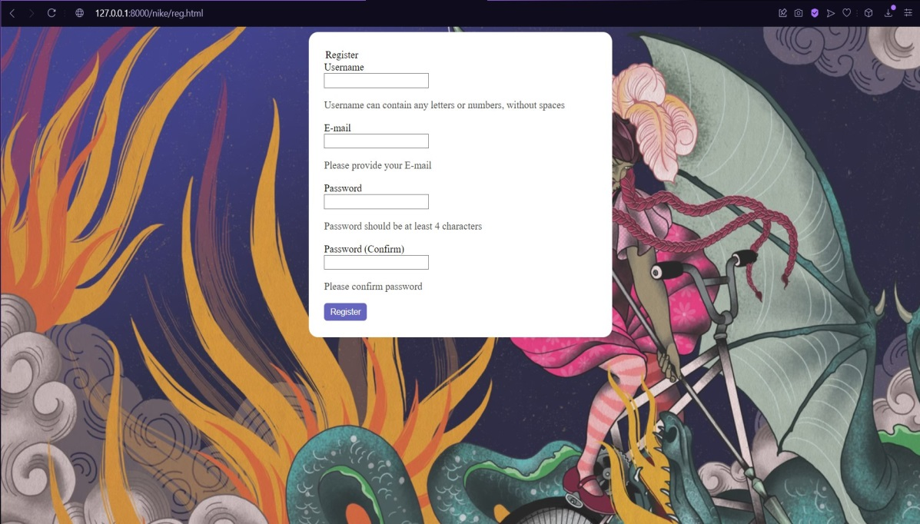
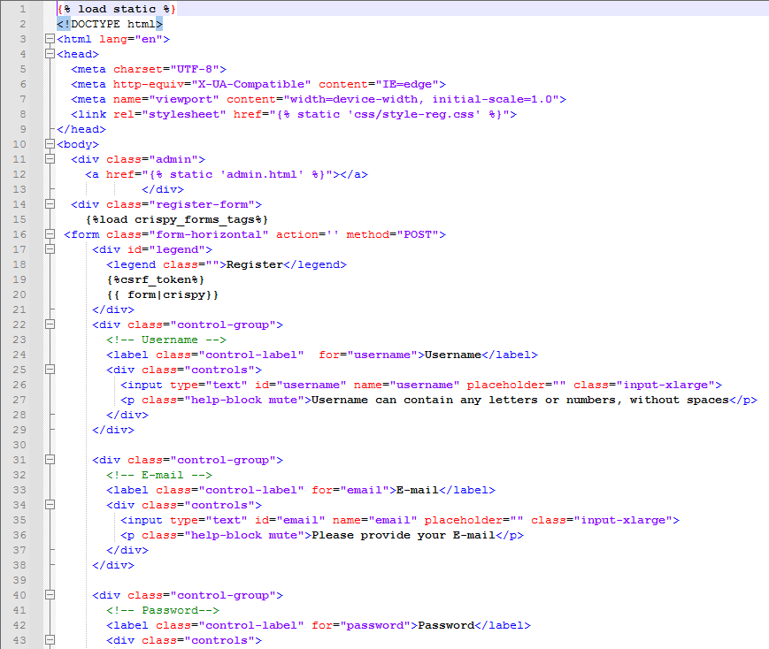
Registration page
Here the user can register. We linked this page to the django database

Slide 5
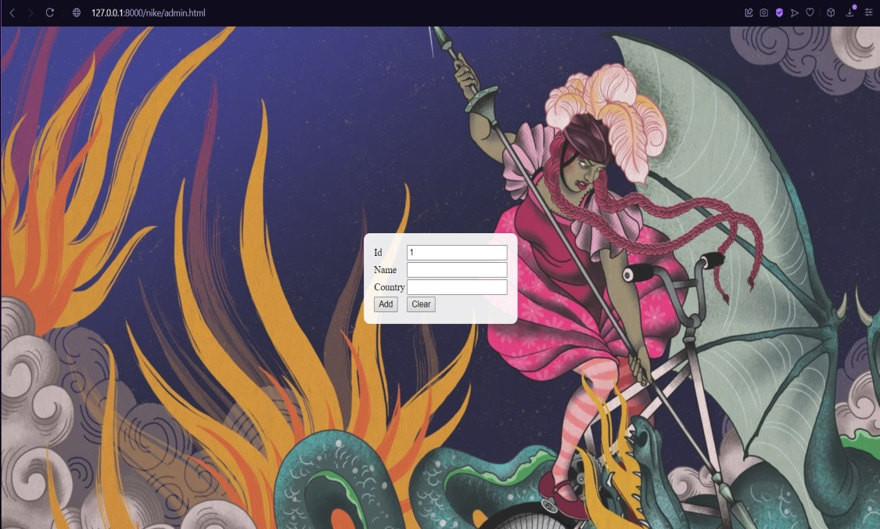
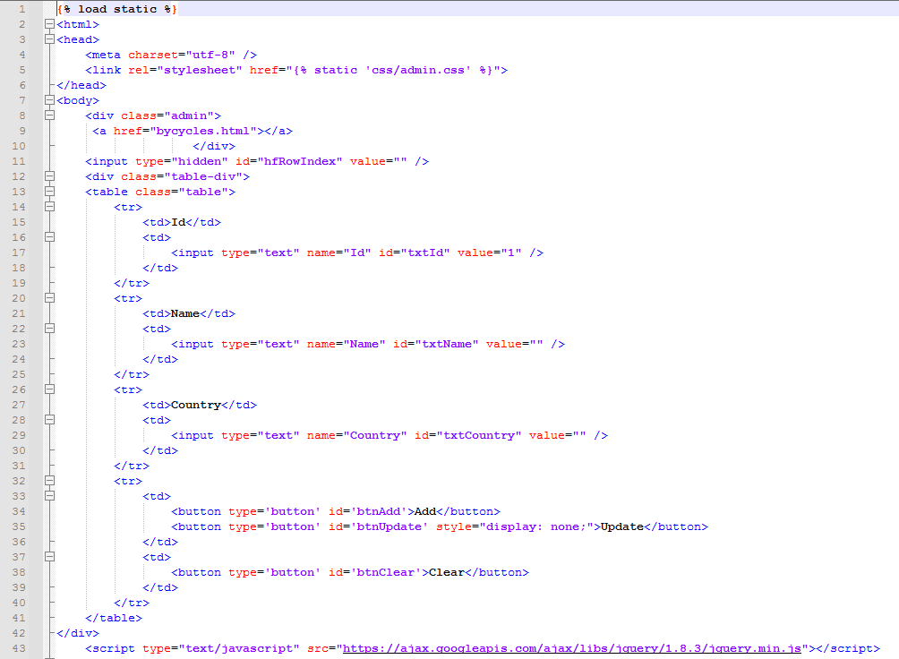
Admin page

Slide 6
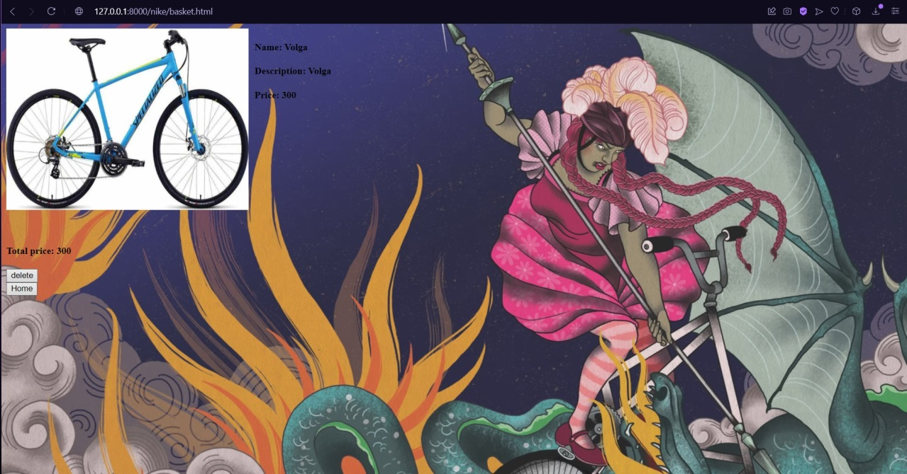
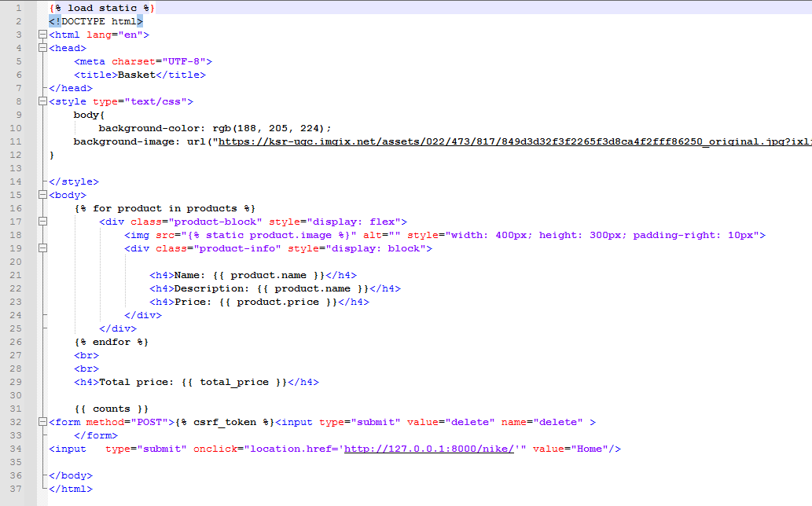
Basket
Here the user can see the products that he has chosen

Slide 7
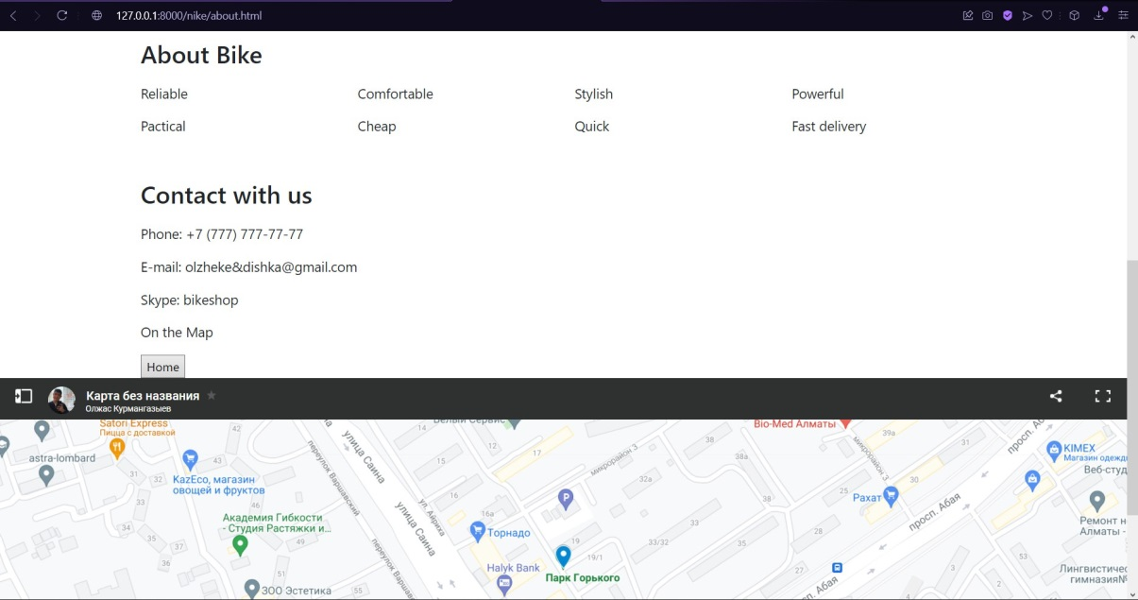
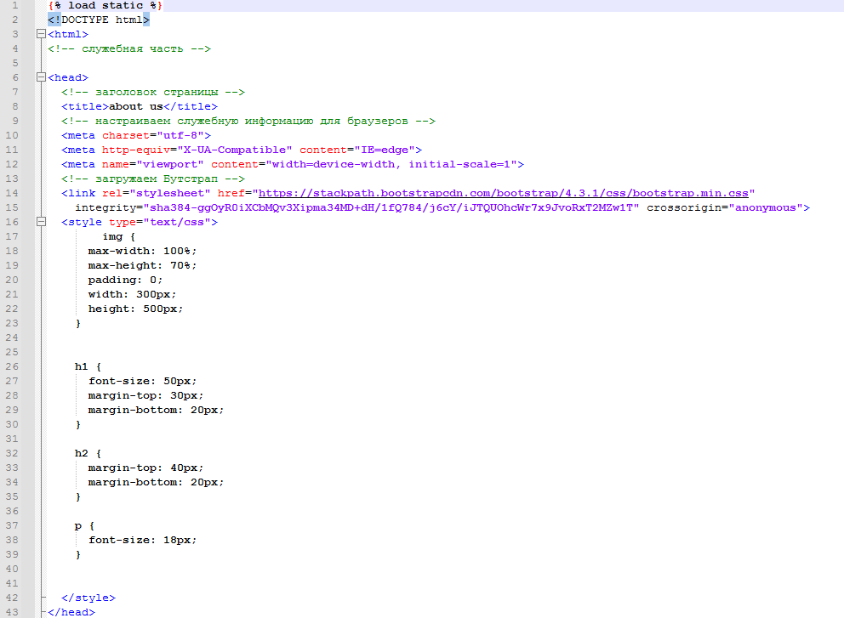
About page
Here users can find out information about us and contact us

Slide 8
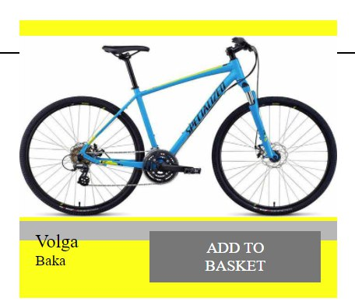
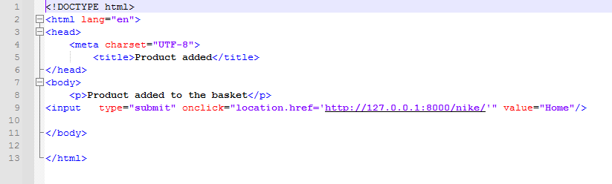
Add to basket

Slide 9
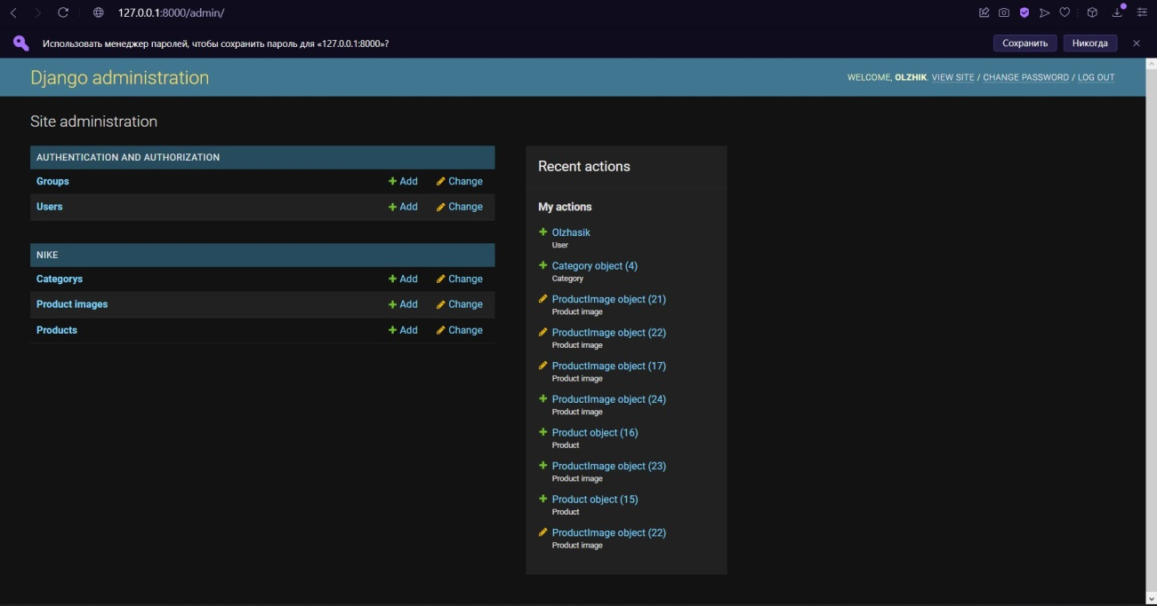
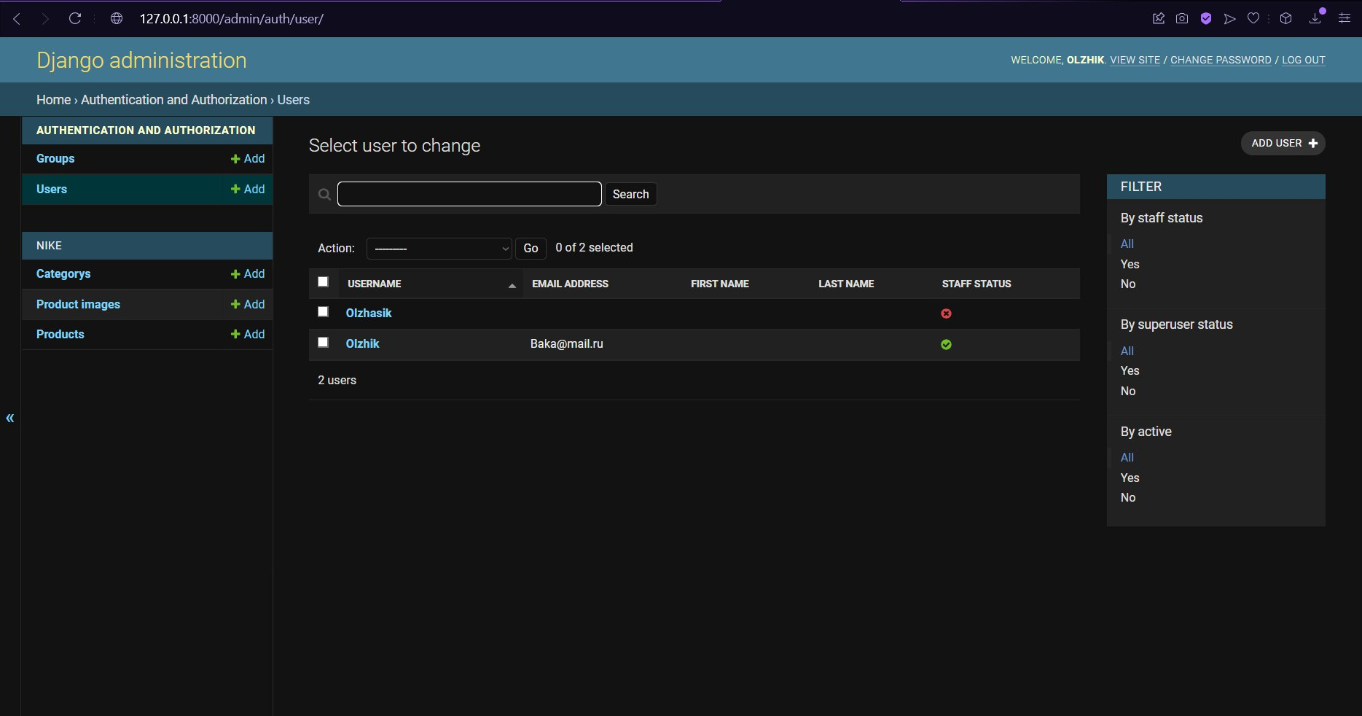
Django admin

Slide 10
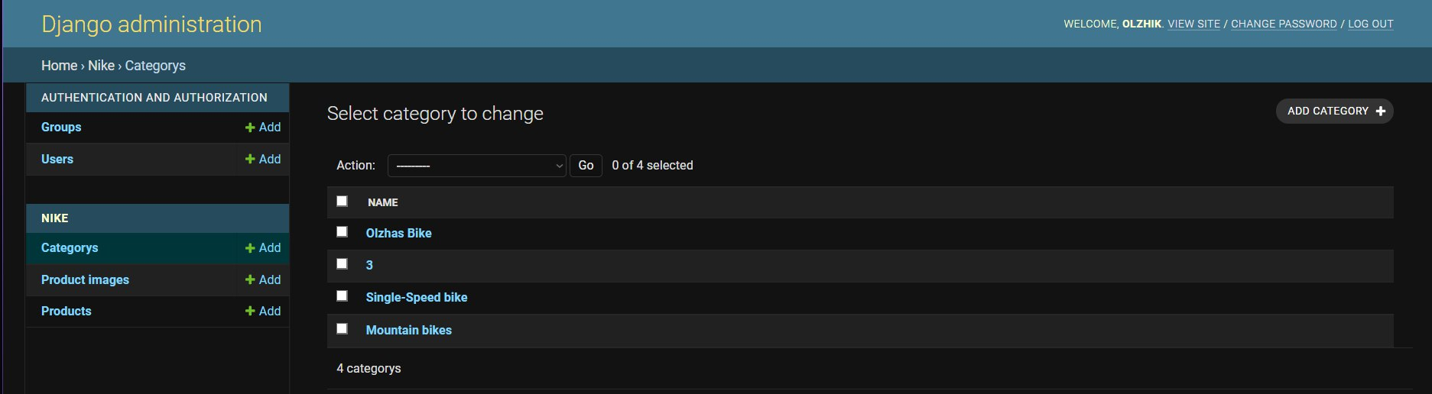
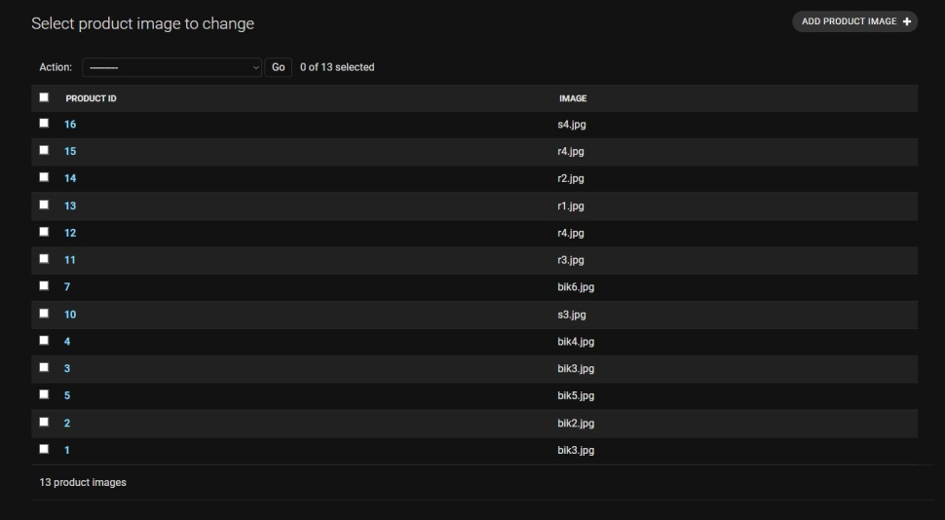
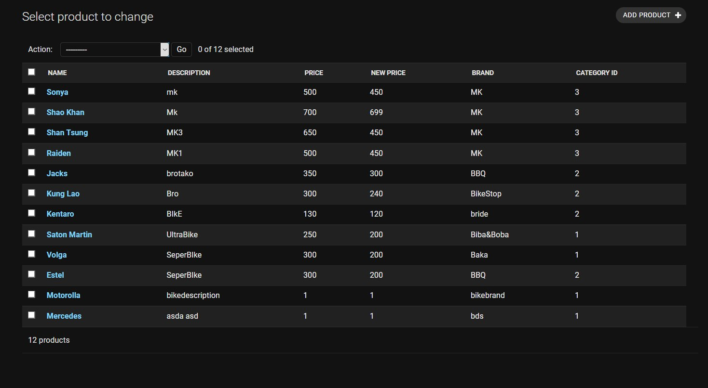
Django admin

Slide 11
In conclusion
In conclusion, I would like to say the site turned out to be not bad and convenient for users, since we tried to make it as simple and convenient as possible.

